Slide 1





Networking in the cloud
Scott Taylor
Network Architect
Internet2
ipv6tech
staylor@internet2.edu

Slide 2

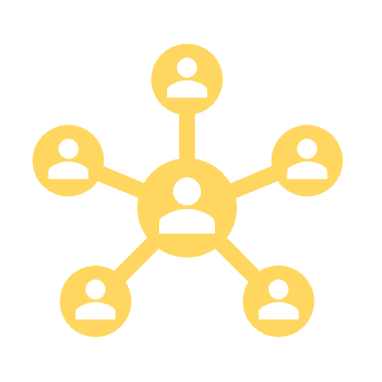


Hybrid and Multicloud

Slide 3
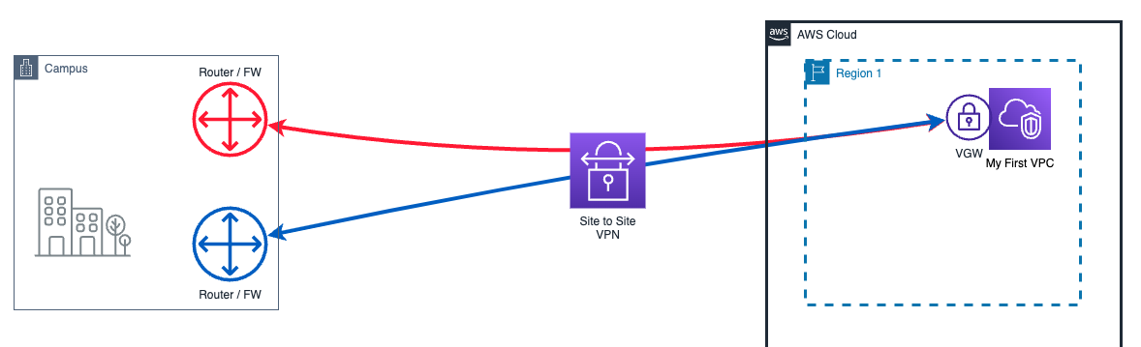
Hybrid
Notes:
Boost network performance
Architect for redundancy
Improve reliability
Reduce cost

Slide 4
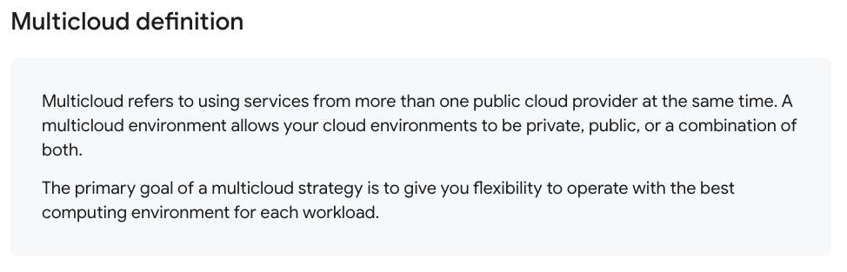
Multicloud
Source: Google Cloud
Notes:
Boost network performance
Architect for redundancy
Improve reliability
Reduce cost

Slide 5
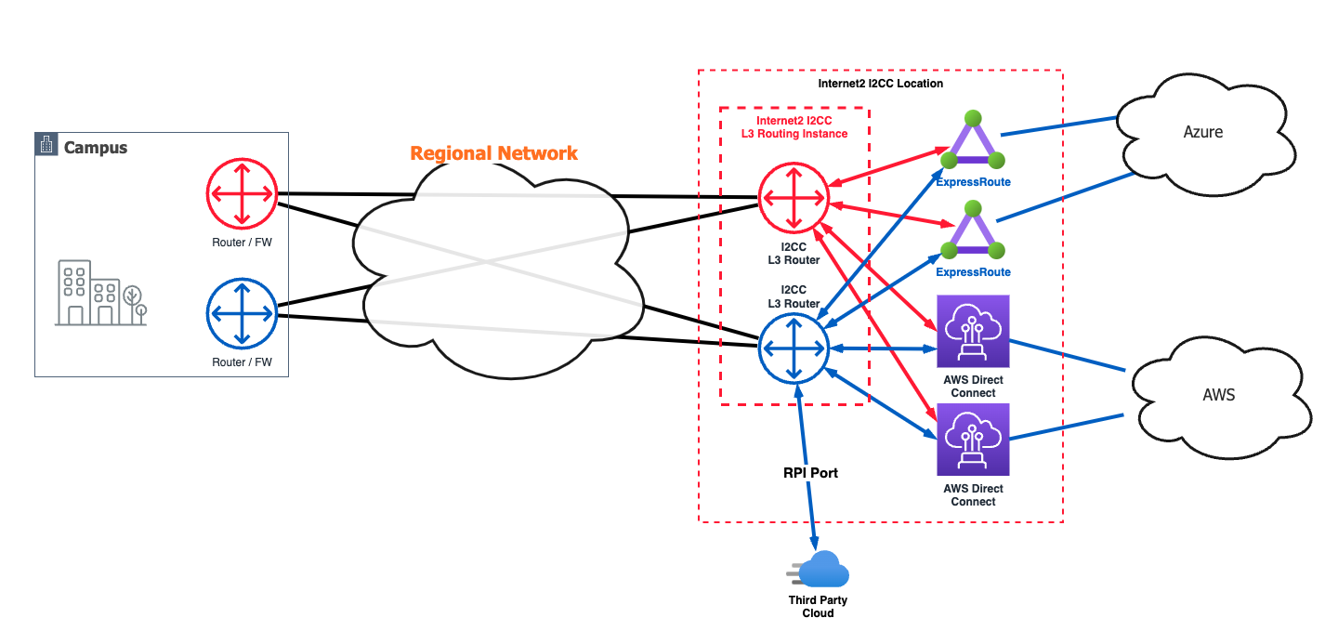
Multicloud
Notes:
Boost network performance
Architect for redundancy
Improve reliability
Reduce cost

Slide 6
Internet2 Cloud Connect
I2CC

Slide 7

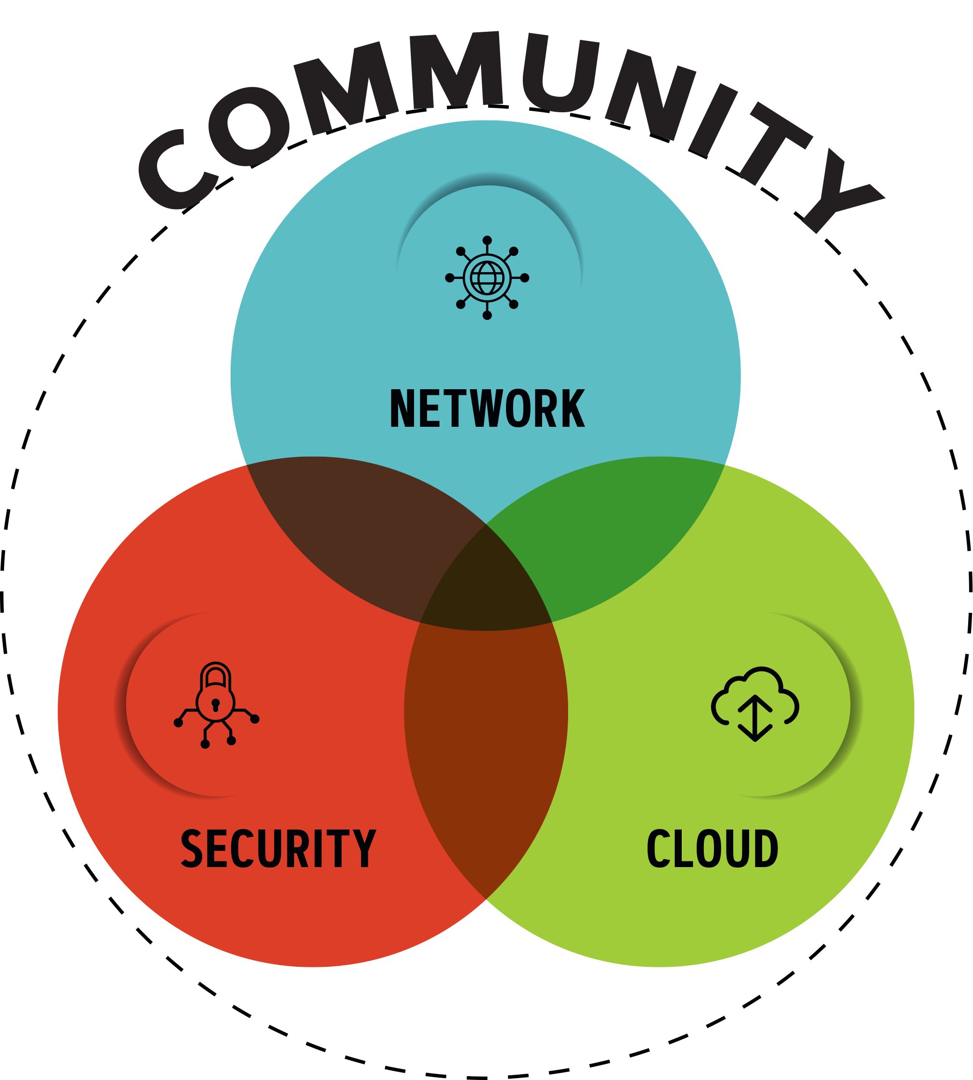
Internet2 Areas of Focus in Support of R&E
Internet2 is a community providing network, cloud and identity solutions, as well as research support and services tailored for R&E.
Our trusted, secure network empowers higher education, research institutions, government entities and cultural organizations.
7

Slide 8
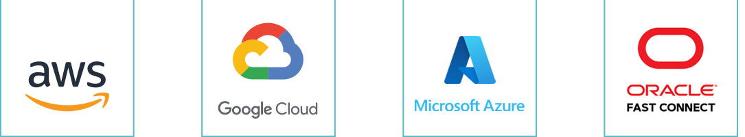
Getting to the Cloud
Internet2 Peer Exchange
I2PX
Use of the community’s existing 3Tbps of peering capabilities to the major cloud providers for access to cloud SaaS services (e.g., Zoom or Office 365)
Internet2 Cloud Connect
I2CC
Enables members to use the Internet2 and their regional’s infrastructure to obtain up to 5Gbps of “direct-connect” private Layer 2 and Layer 3 access to Amazon, Google, Microsoft, or Oracle cloud platforms at no additional fee. Extending your data center to the cloud. (Cloud provider fees apply)
Internet2 Rapid Private Interconnect
I2RPI
Provides private 10G interconnections at major peering points across the country at low annual rates. Leverages current investment in <regional network> and Internet2 infrastructures to reach cloud providers, for dedicated access or improved resiliency. May be used to connect to any commercial provider located at the peering point.

Slide 9
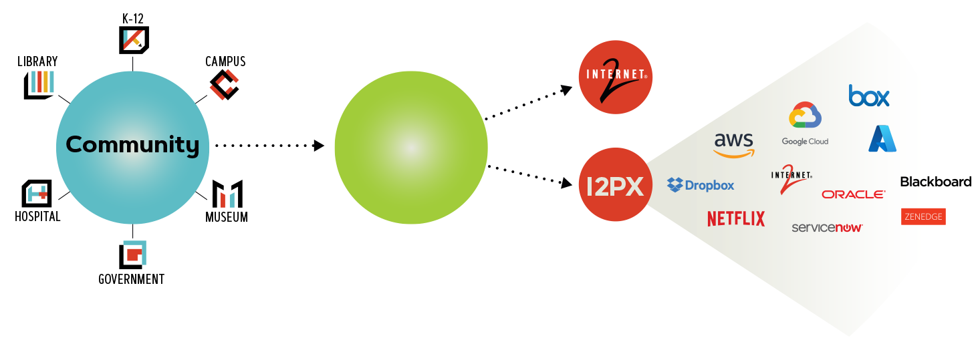


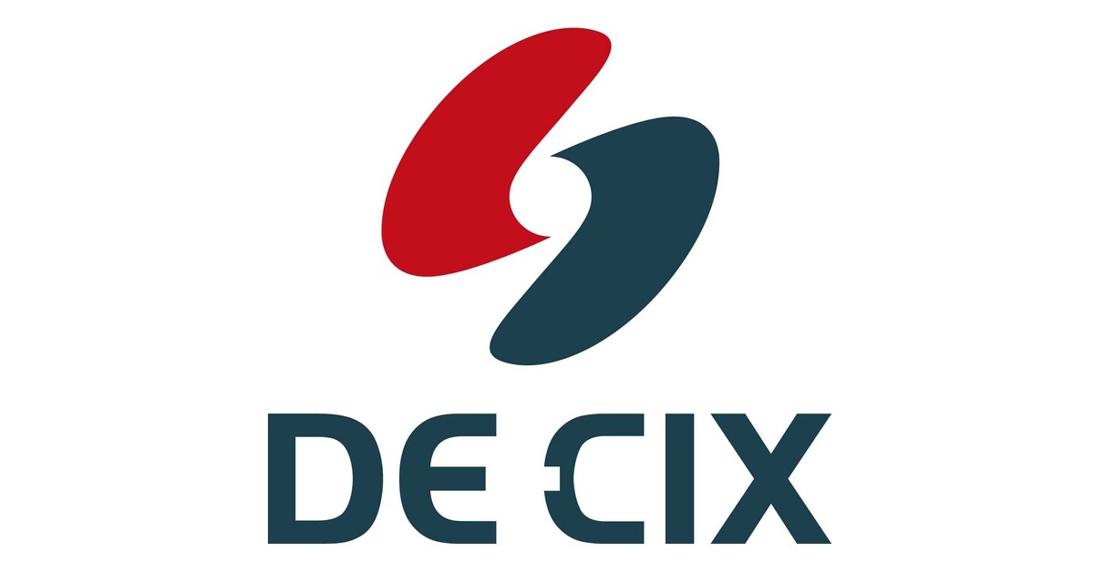

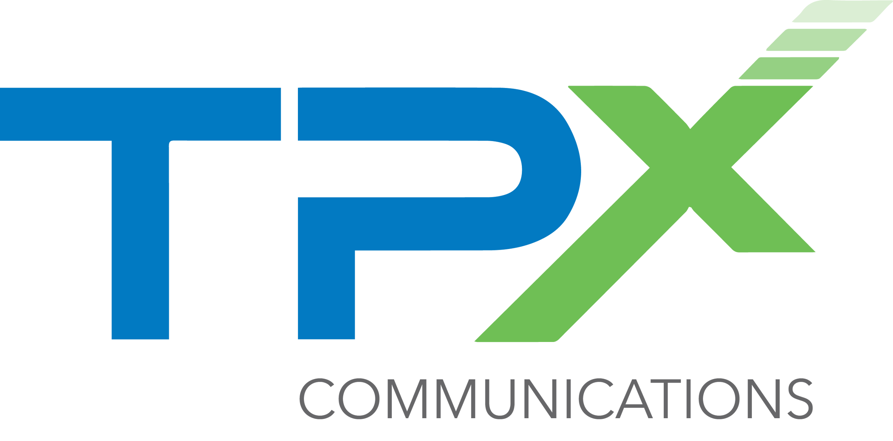


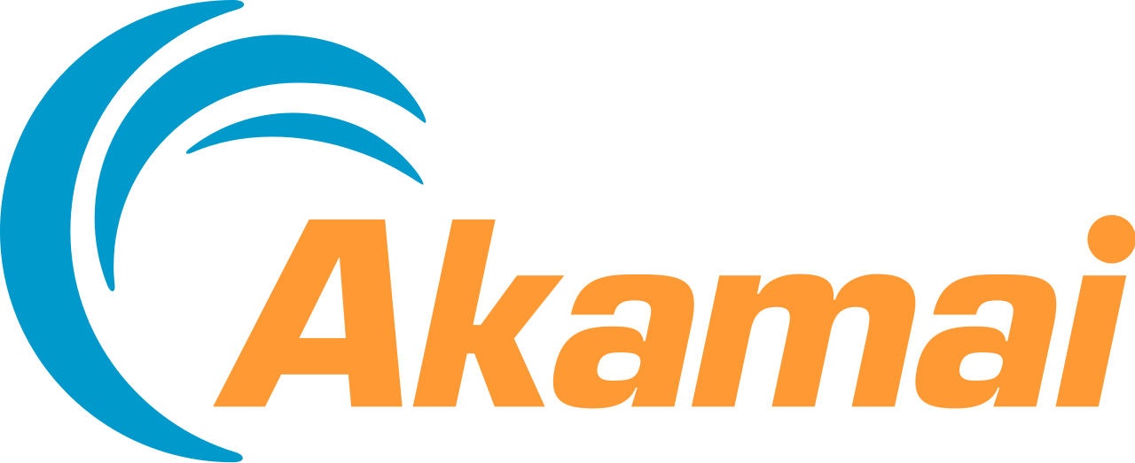


Designed from the ground up to meet the R&E Needs
Internet2 Peer Exchange
I2PX
REN
Allows REN to have high performing on-net access to cloud service providers, avoiding the commodity internet
Designed from the ground up to focus on hosting cloud providers most valued by the R&E community
Available to REN members today at no additional fee

Slide 10
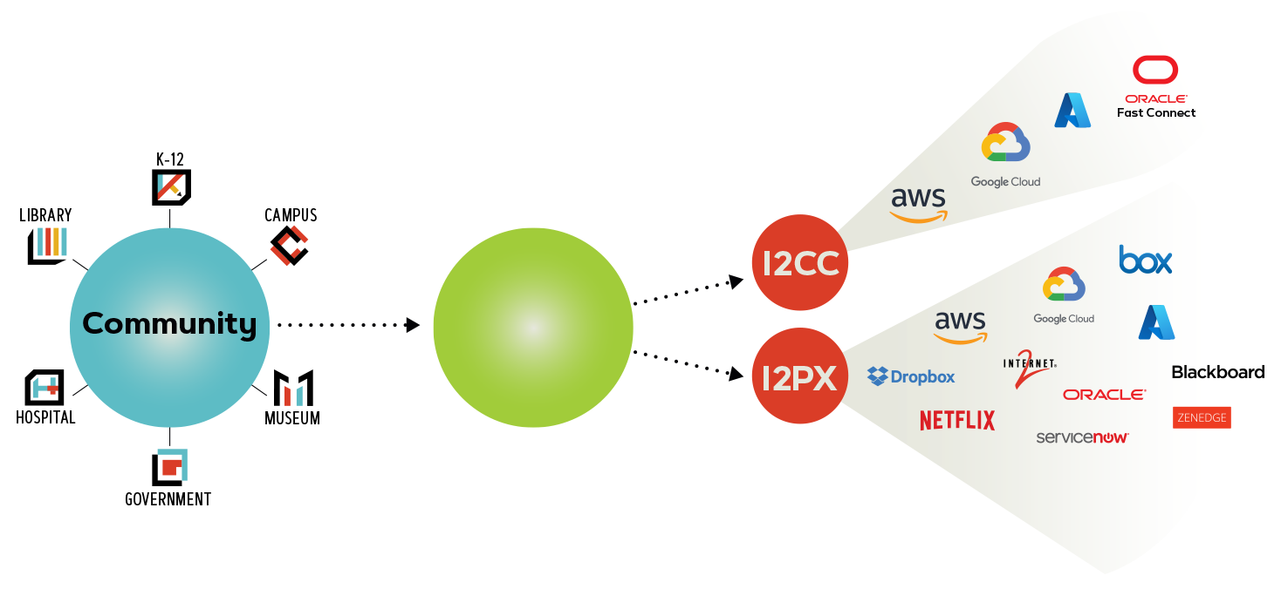
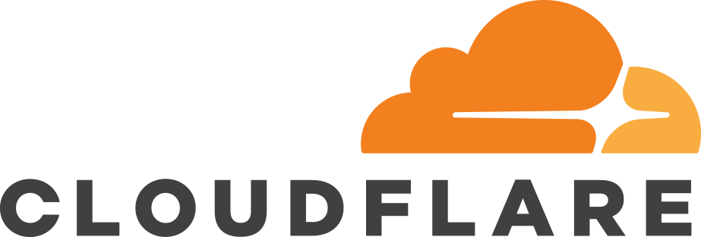

Leveraging R&E Networks for Direct Cloud Connections
Internet2 Cloud Connect
I2CC
REN
REN members can connect at Layer 2 or Layer 3
REN members can use Cloud Connect with up to 5Gbps connections to Amazon Direct Connect, Google Cloud Partner Interconnect, Microsoft Azure Express Route or Oracle FastConnect services
Available to REN members today at no additional fee

Slide 11
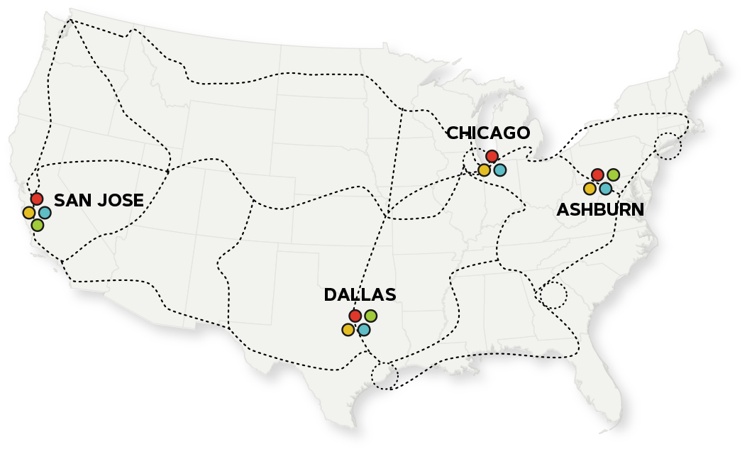




Nationwide Connectivity
Internet2 Cloud Connect
I2CC
Amazon Direct Connect
Google Cloud Interconnect
Microsoft ExpressRoute
Oracle Fast Connect
Notes:
Cloud Connect AWS

Slide 12
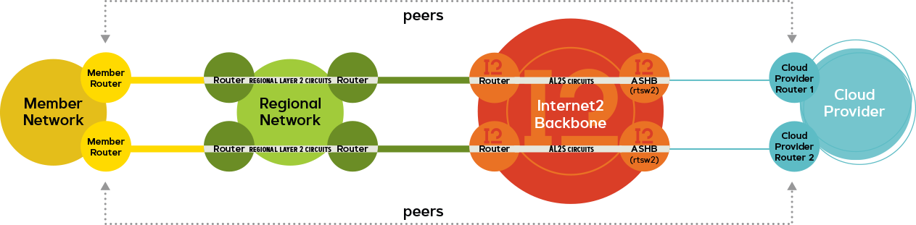
Layer 2 Connection Option
Internet2 Cloud Connect
I2CC
Notes:
Cloud Connect AWS

Slide 13
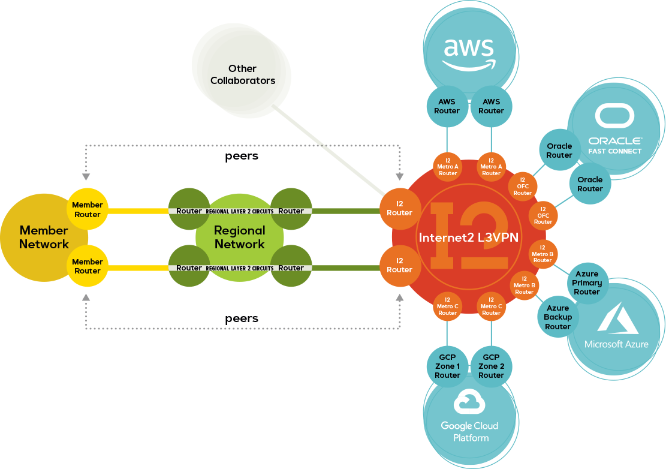
Layer 3 Connection Option
Internet2 Cloud Connect
I2CC
Notes:
Cloud Connect AWS

Slide 14
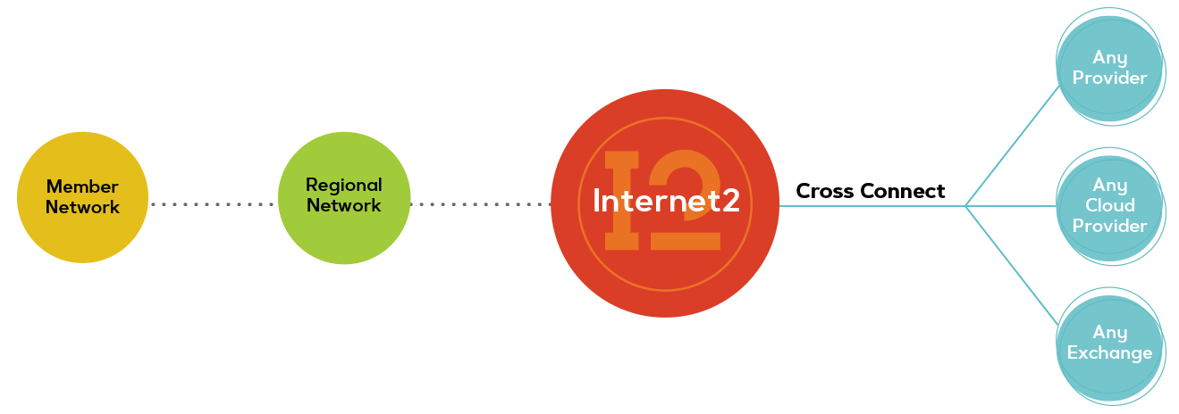
Flexible Connections to Any Provider
Internet2 Rapid Private Interconnect
I2RPI
Available through Network Connectors for an additional fee
Connect at Layer 2 or Layer 3
Private 10G dedicated connections to Amazon Direct Connect, Google Cloud Interconnect, Microsoft Azure ExpressRoute, or Oracle Fast Connect services
Private 10G dedicated connections to ANY service provider at major peering points
Notes:
Cloud Connect AWS

Slide 15
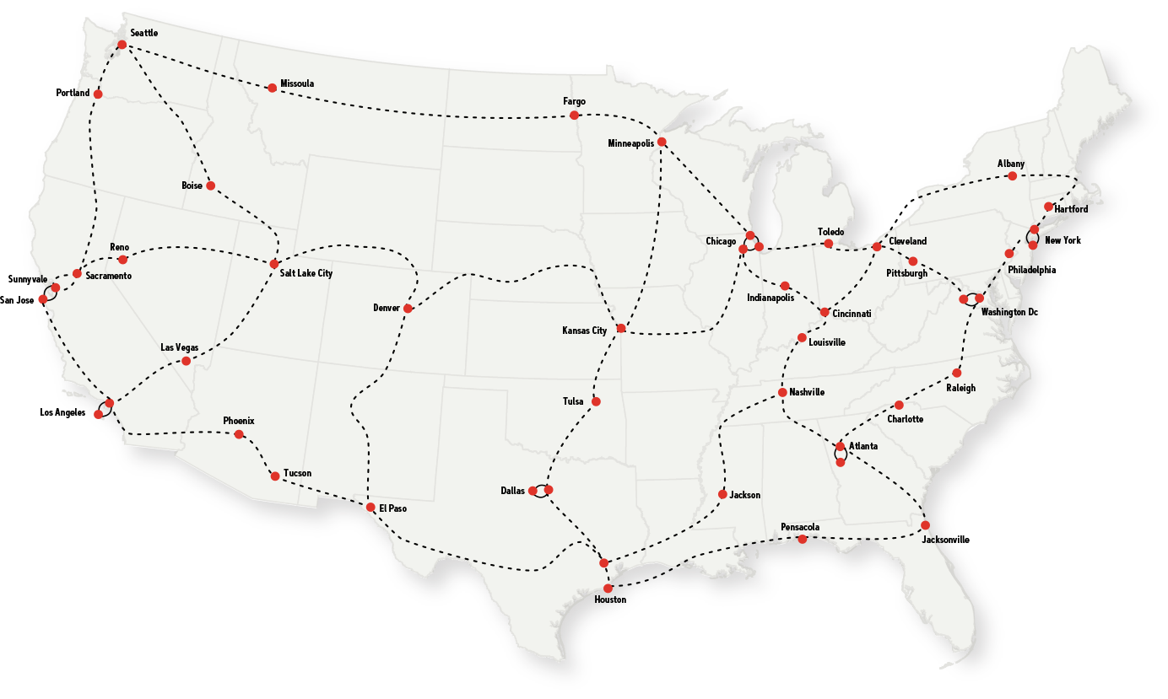
Nationwide Connectivity
Internet2 Rapid Private Interconnect
I2RPI
can be used to provide private direct connects to any provider with some examples being 10G connections to SIP service providers, esports exchanges or other cloud providers.
Notes:
Cloud Connect AWS

Slide 16
Why, HOW, AND WHEN to use I2CC

Slide 17
Why, how, and when to use I2CC
Boost Network Performance
Architect for Resiliency
Simplify Connectivity
Better Supportability
Reduce Costs
Notes:
Boost network performance
Architect for redundancy
Improve reliability
Reduce cost

Slide 18
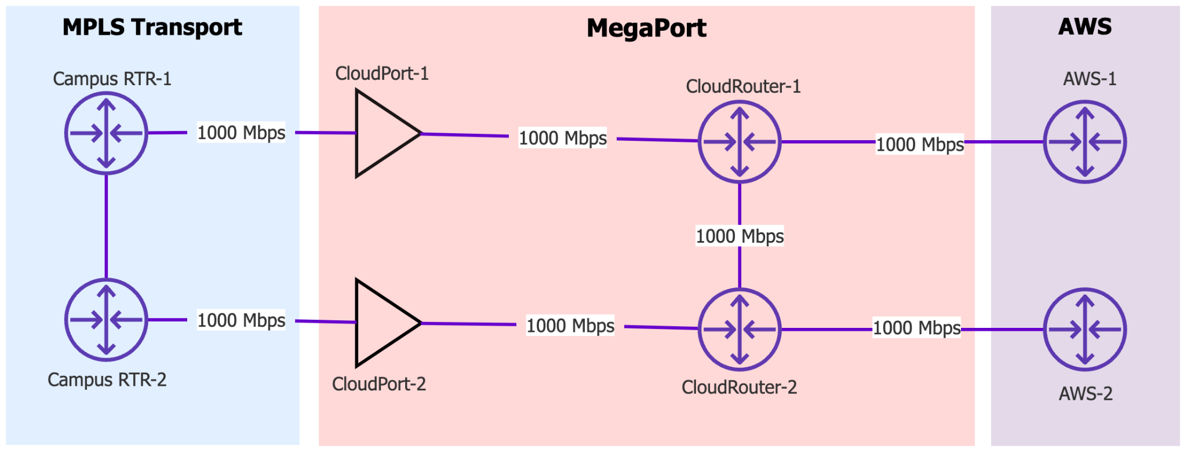
Reduce Costs
Notes:
Let’s talk cost for a second.

Slide 19
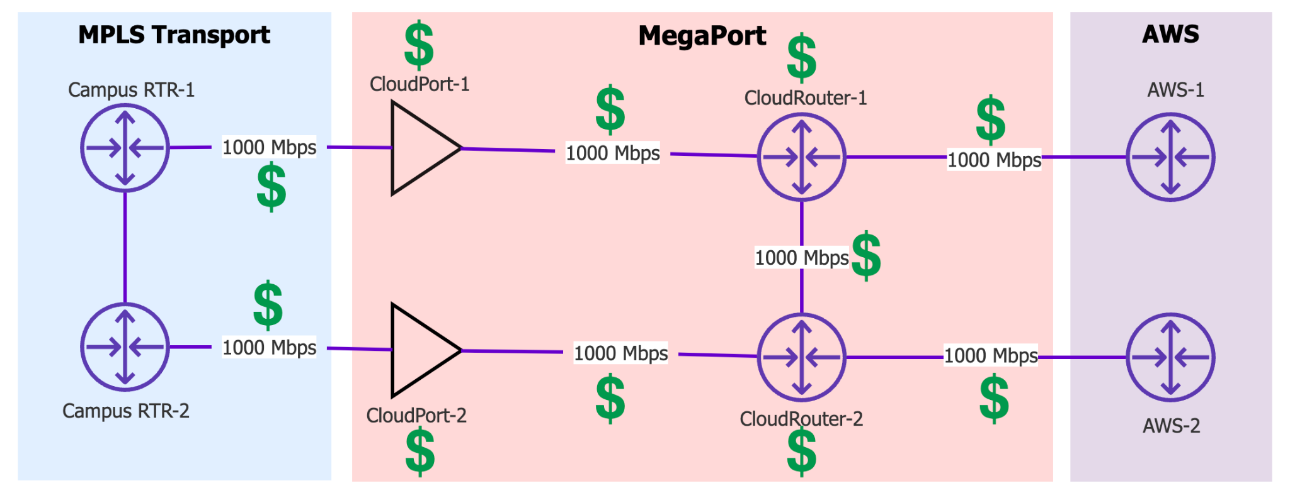
Commercial Example
Notes:
Performance
Simplification
Cost Savings with Internet2
Are you doing this?! VPN between cloud providers…
How about this?! hairpin traffic back to Campus
Or this?!! VPN Hell!
Or worse VPN to every VPC + Cloud?!
How about

Slide 20
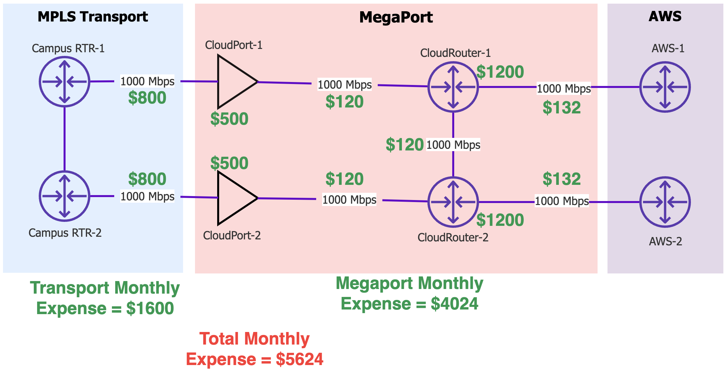
Monthly Expense

Slide 21
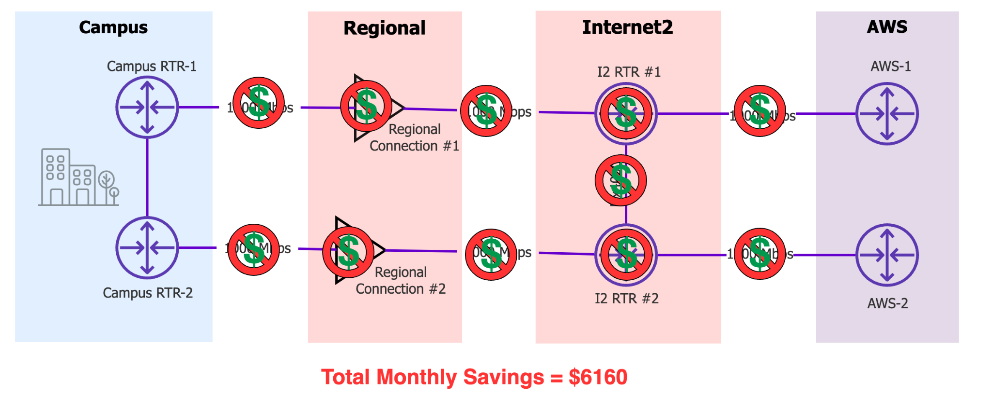
I2CC Monthly Savings
Total monthly saving: $5,624

Slide 22
Insight Console
Overview

Slide 23
Internet2 Insight Console
Sections covered
Community – Organize child organizations and add users
Interfaces – View interfaces or VLANs and delegate VLANs to other Orgs
Virtual Networks – Configure new connections/services
Looking Glass – Troubleshoot

Slide 24
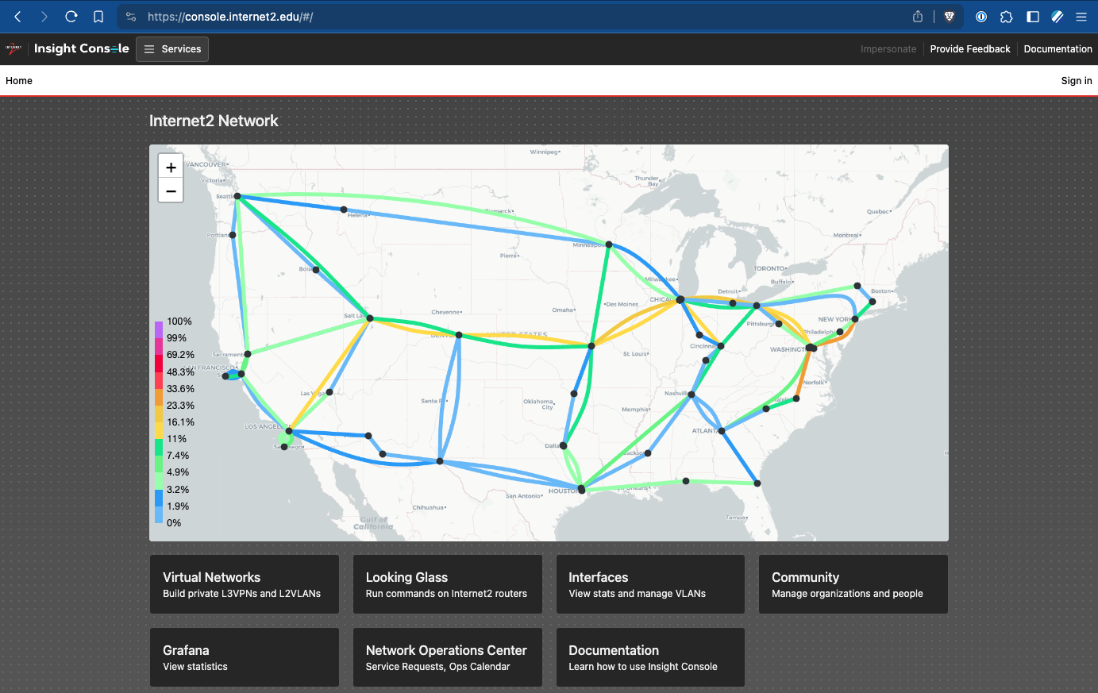
Internet2 Insight Console
https://console.internet2.edu

Slide 25
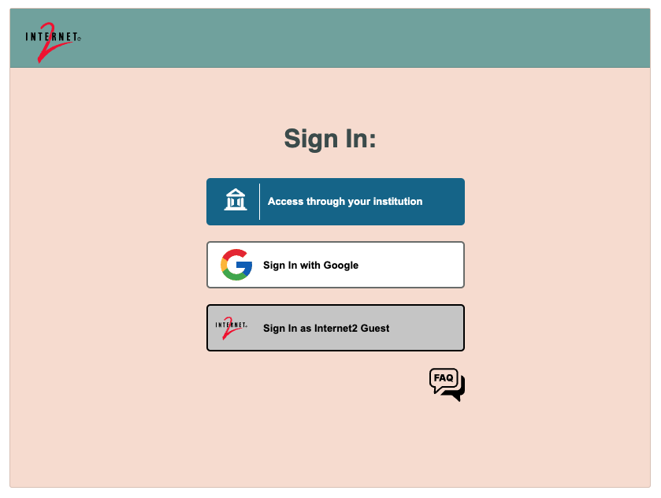
Internet2 Insight Console
Access through your institution is the preferred method.
If your institution uses Incommon you’ll likely have the ability to sign in.
You might need Internet2 to create or move your institution into the correct hierarchical tree structure.

Slide 26
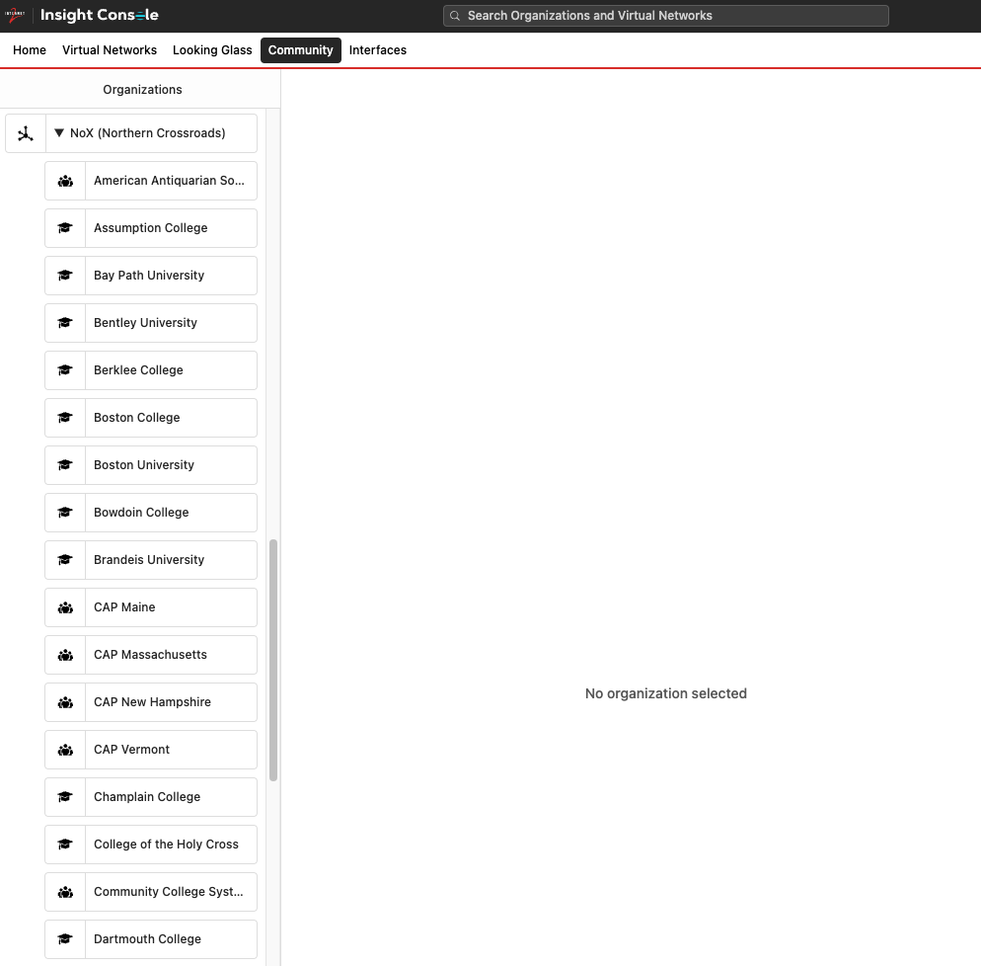
Community
Organize child organizations and add users

Slide 27
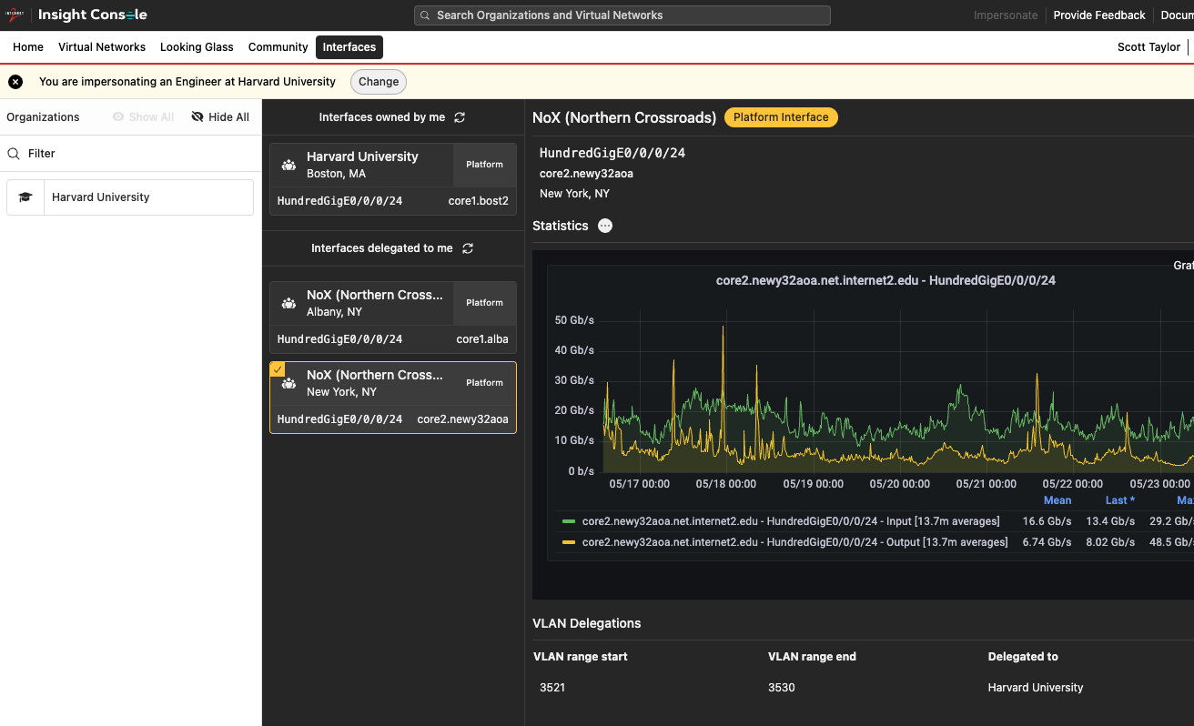
Interfaces
View interfaces or VLANs and delegate VLANs to other organizations

Slide 28
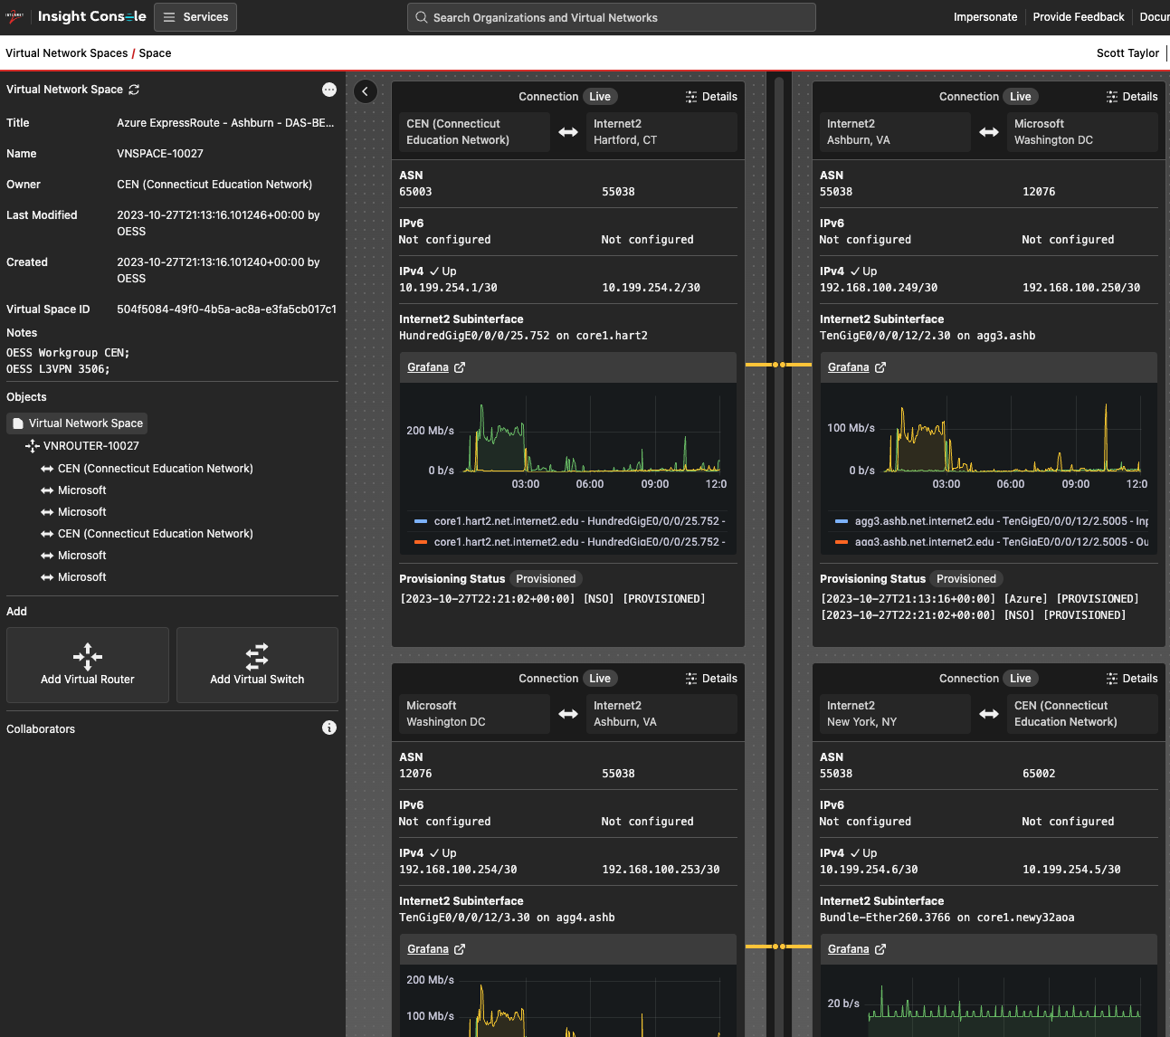
VIRTUAL NETWORKS

Slide 29
Networking Components

Slide 30
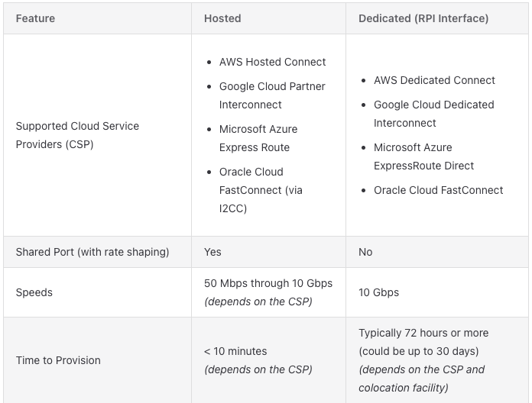
Hosted v Dedicated Cloud Connections
The Internet2 Cloud Connect “Hosted” connections are often referred to as Partner or Provider connections

Slide 31
Best Practices
Build dedicated connections into each region that you have infrastructure
Leverage redundant connections in each region
Consider VPN for backup connectivity
Use BGP where possible for dynamic routing
Use BFD wherever possible for quicker failover (< 1-second) (typical default holdtime is 90 – 180 seconds)

Slide 32
Why Layer 3
We came here to learn and play with networking and routing, right?
While we can build Layer 2 connections into the clouds at some point you need to configure Layer 3 addressing and routing to move bits around.
BGP is universally leveraged for dynamic routing
Static routes are universally leveraged for static routing

Slide 33
IP Address Planning
IP Planning is critical !!!
Ensure nonoverlapping address / CIDR ranges are used
Don’t use entire private CIDR ranges
Plan and reserve space for future
Fewer large virtual networks rather than multiple small virtual networks to prevent overhead
Use IPv6 where possible
Gain experience
Future proof services
Same rules as above apply to IPv6 space

Slide 34
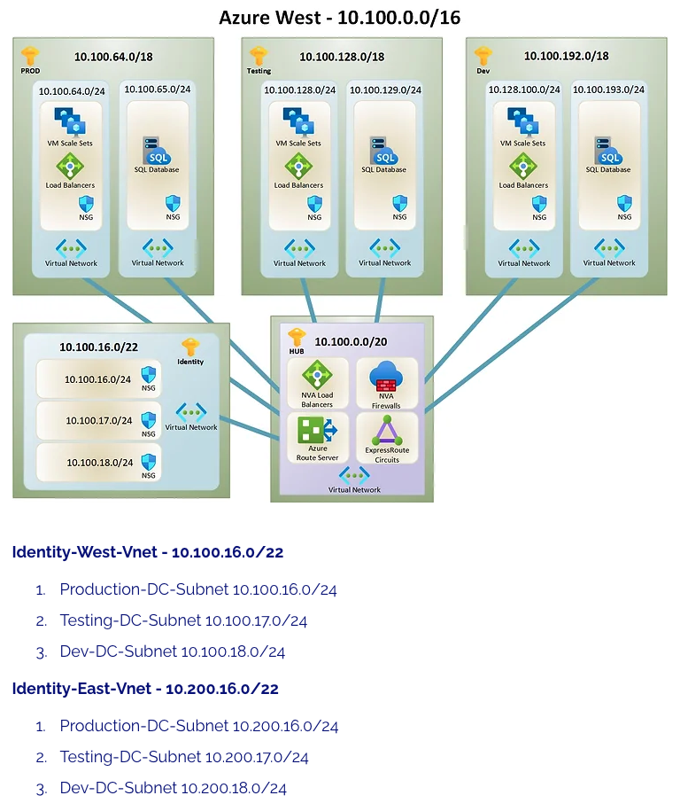
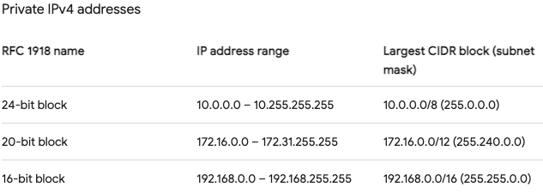
IP Address Planning

Slide 35
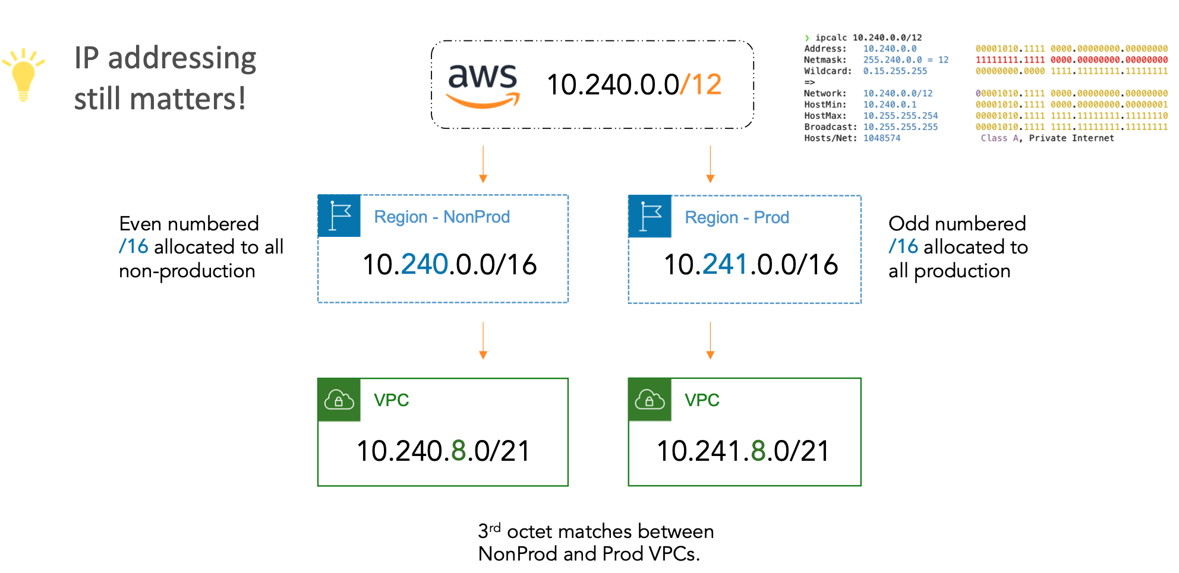
IP Address Planning
Source: https://github.com/wcollins

Slide 36
ASN Planning
Internet2 Cloud/Virtual Router to use ASN 55038
Google Cloud Router to use ASN 16550 (for partner interconnects)
Azure ExpressRoute to use ASN 12076
Oracle FastConnect to use ASN 31898
AWS DirectConnect to use a private ASN you configure << DANGER!

Slide 37
ASN Planning
ASN Planning is important especially as you enter multiple clouds and want to extend your private network or combine CSP’s into a multicloud environment.
Know your campus/data center ASN architecture
Best practice to use a unique ASN for each Cloud Region
Leverage private 16-bit and 32-bit ASNs
Private ASN ranges (RFC 6996): 64512 - 65534; 4200000000 - 4294967294

Slide 38
AWS
AWS connections start in Insight Console/Virtual Networks
Accept the hosted connection in the AWS Console > AWS Direct Connect > Connections
AWS services typically makes use of private ASN range 64512 – 65534
Specific Services:
DXGW: ASN Range: 64512 – 65534
VPG: ASN Default: 64512 (Custom allowed 64512 – 65534)
TGW: ASN Range: 64512 – 65534

Slide 39
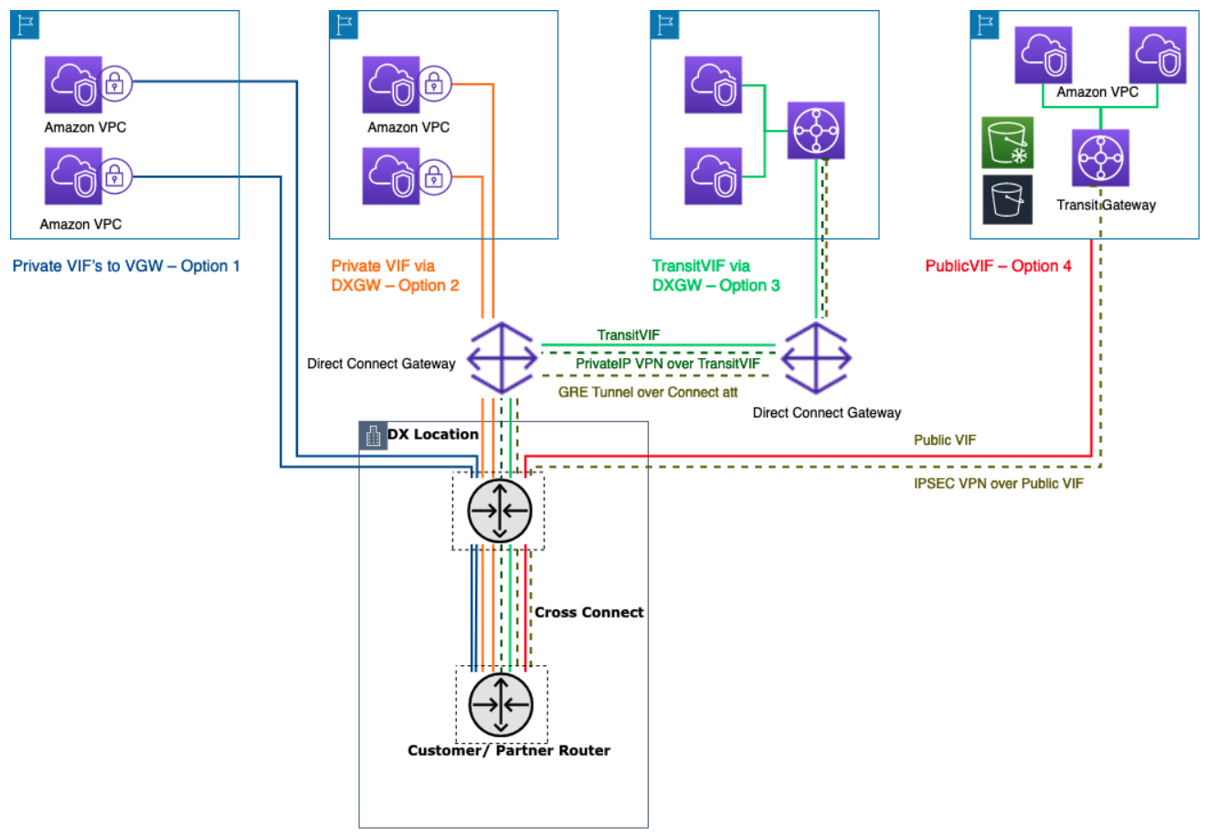
AWS: Let me count the ways

Slide 40
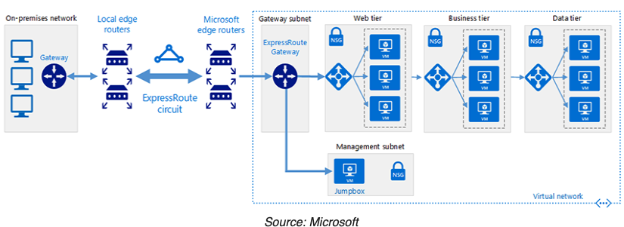
Azure
Azure connections start in the Azure portal
Create a new ExpressRoute; copy the “SERVICE ID”
Use service ID in Insight Console
I2CC

Slide 41
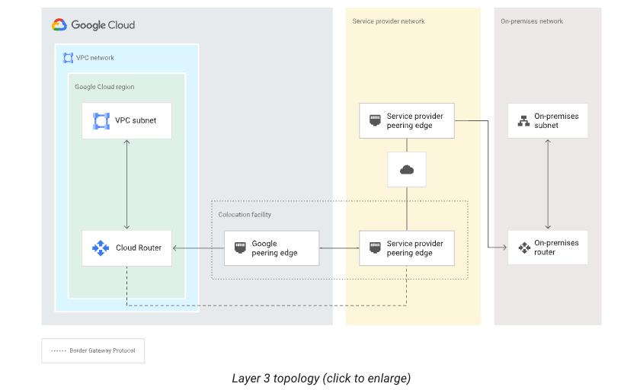
Google Cloud
Google Partner Interconnect connections start in Google Cloud

Slide 42
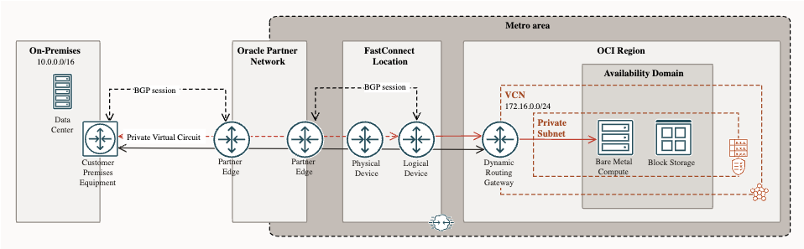
Oracle Cloud
Oracle FastConnect connections start in Oracle Cloud
I2CC

Slide 43
PREFIX LIMITS
AWS Direct Connect
Private peering: Accepts up to 100 prefixes each for IPv4 and IPv6
Public peering: Accepts up to 1000 prefixes
BGP state goes to idle (BGP peering goes down)
Azure Express Route
Private peering: Accepts up to 4000 prefixes
Public peering: Accepts up to 200 prefixes
BGP session is dropped
Oracle FastConnect
Public peering: Accepts up to 200 prefixes
Private peering: Accepts up to 2000 prefixes
BGP session brought down?
Google Cloud Interconnect/Cloud Router
Less straightforward, no published limits on Interconnect; limits exist on Cloud Router Important number to keep in mind is 250 prefixes
BGP doesn't go down instead uses deterministic route dropping behavior

Slide 44
Follow Along
Demonstration

Slide 45
CONCEPT
Leveraging Internet2 Cloud Connect we will establish private connections to the cloud service providers and learn how to inspect prefixes seen on the Internet2 Cloud Router.
Private peerings
Non-redundant connections
Lowest bandwidth
Internet2 Virtual Routers / Cloud Routers are a distributed resource and fully redundant.
It is not necessary to have more than one Internet2 Cloud Router
! Today you can’t peer the Internet2 cloud routers together
IPv6 addressing is optional for our follow along

Slide 46
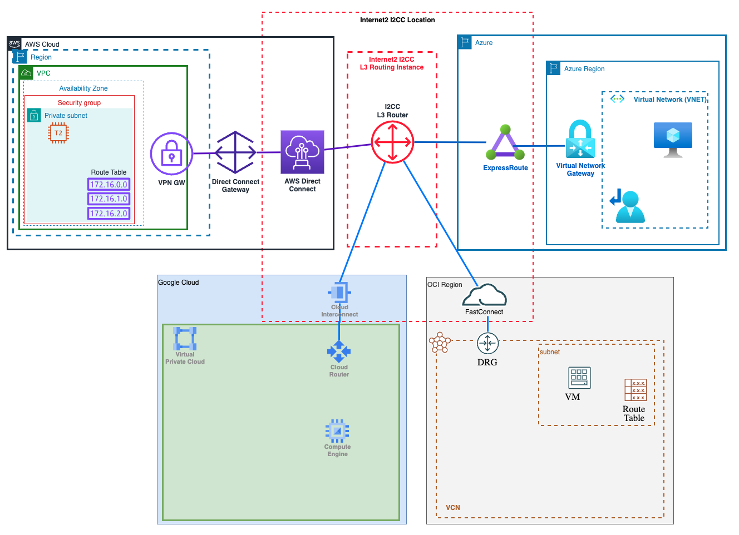
Multicloud

Slide 47
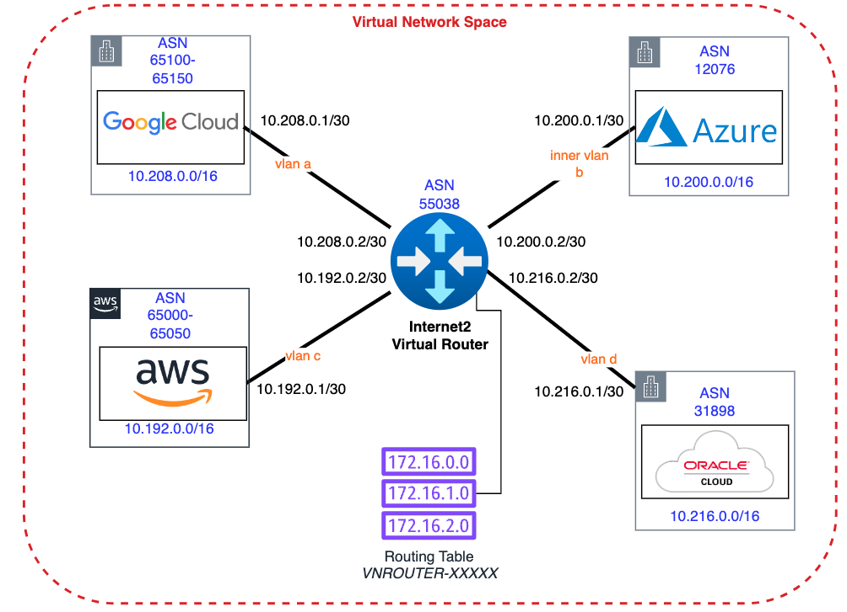
Address Plan

Slide 48
Addressing
AWS VPC 10.192.0.0/16
Subnets
DX Peering: 10.192.0.0/30
TGW: 10.192.0.240/28
Public: 10.192.1.0/24
Azure VNET 10.200.0.0/16
Subnets
ER Peering: 10.200.0.0/30
VNG: 10.200.0.240/28
Public: 10.2.2.0/24
Google VPC 10.208.0.0/16
Subnets
Public: 10.208.1.0/24
Oracle VCN 10.216.0.0/16
Subnets
Public: 10.216.1.0/24

Slide 49
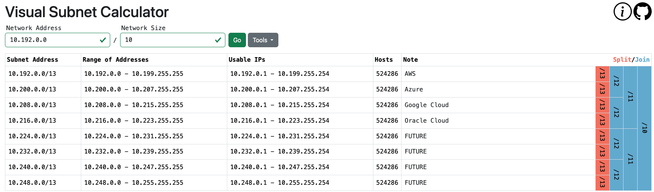
Address Plan
https://visualsubnetcalc.com

Slide 50
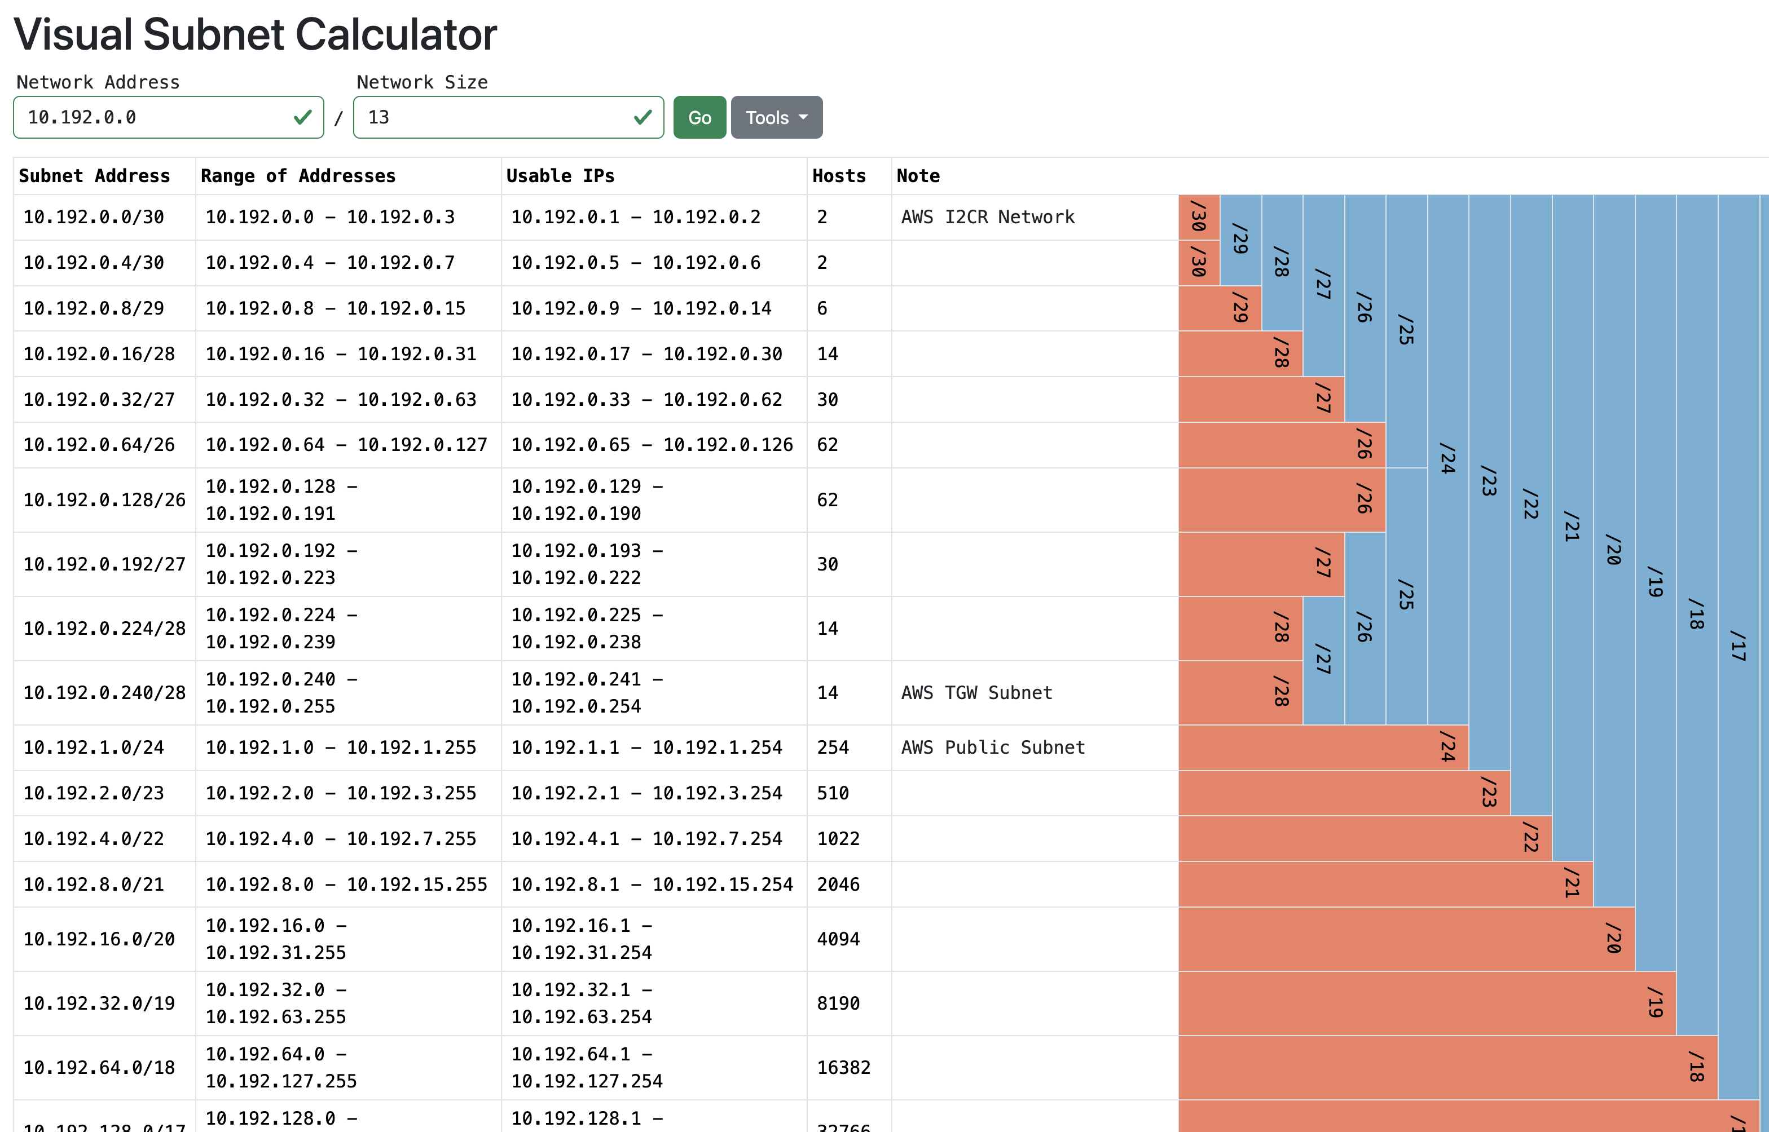
AWS specific example

Slide 51
Insight Console Access
Everyone registered was added to a workshop Organization
Navigate to https://console.internet2.edu
Under Virtual Networks search for class-workshop

Slide 52
Insight Console Access
Suggest that everyone create a new Virtual Network Space
Create a router in your network space
We do not have a mock campus environment for this hand-on lab

Slide 53
LOOKING GLASS
TIPS & TRICKS

Slide 54

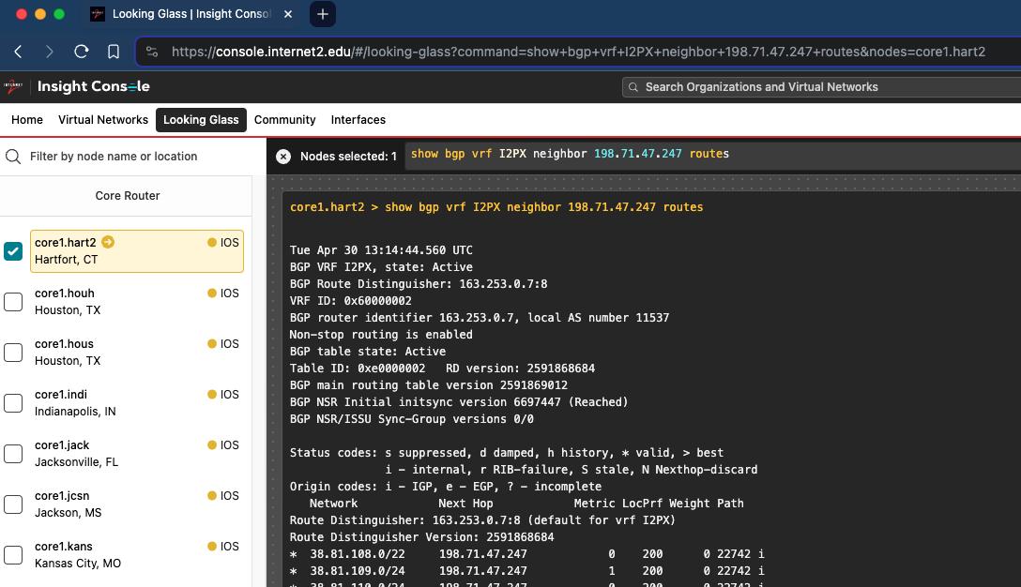
Looking Glass Tip & Tricks
Bookmark your query so you can quickly return and re-run the same query

Slide 55
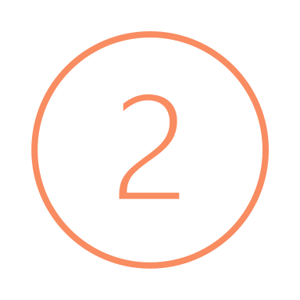
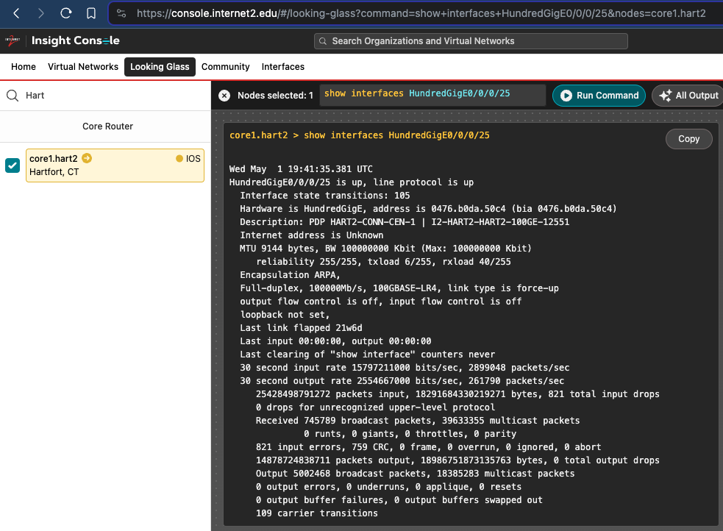
Looking Glass Tip & Tricks
Show Interface state/counters/link flaps/etc.
Useful for:
Network Connector Interfaces
e.g. CEN - Hart2 HundredGigE0/0/0/25
Notes:
Point out the ability to find the Interface in Virtual Networks and then use Looking Glass to check on the

Slide 56
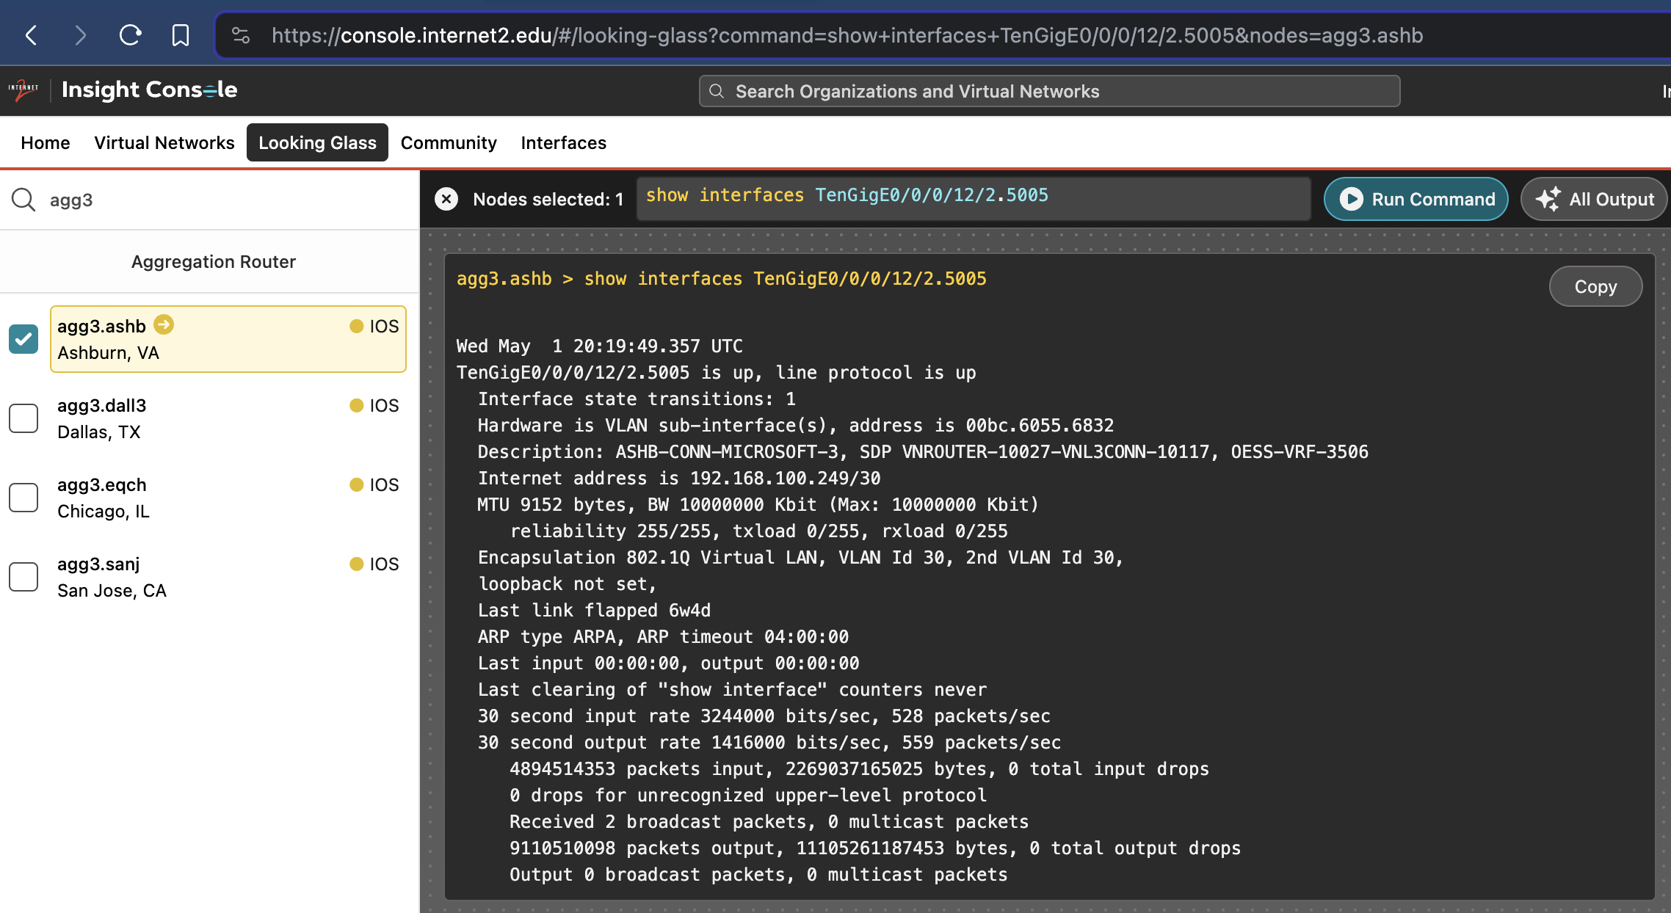
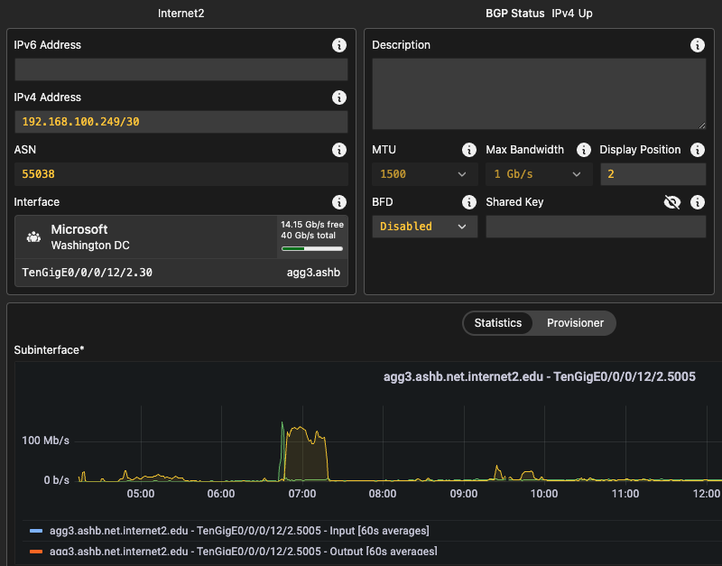


Looking Glass Tip & Tricks
Cloud Provider Interfaces
e.g. Azure – Agg3.ASHB
TenGigE0/0/12/2.5005
Notes:
Point out the ability to find the Interface in Virtual Networks and then use Looking Glass to check on the

Slide 57
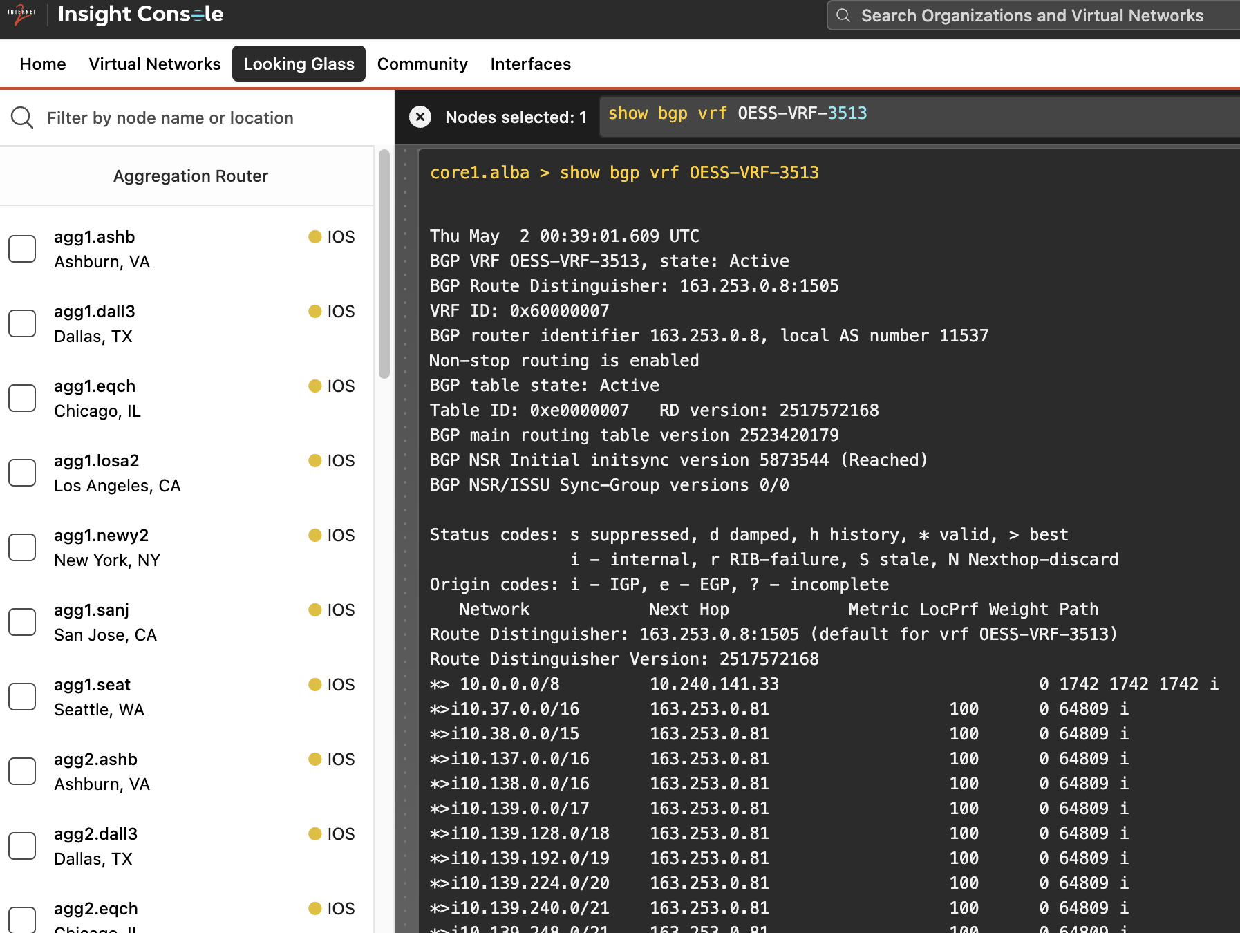

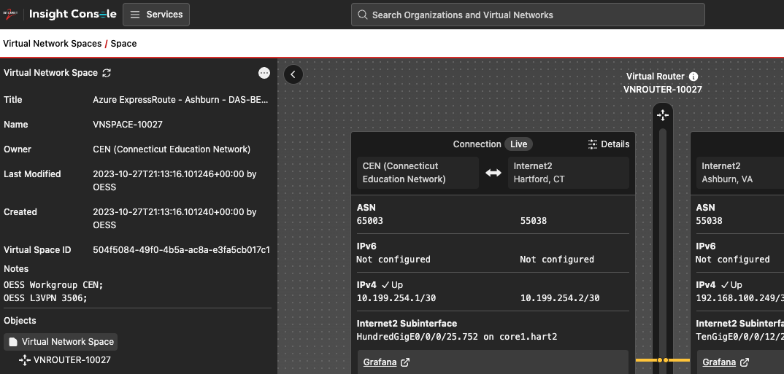
Looking Glass Tip & Tricks
View routing table for Virtual Networks
Newer: show bgp vrf VNROUTER-XXXXX
- unless migrated from OESS -
Older: show bgp vrf OESS-VRF-XXXX
Notes:
Point out the ability to find the Interface in Virtual Networks and then use Looking Glass to check on the

Slide 58
Clean-up your cloud
Don’t forget!!!
! Delete all your resources in the various CSP’s
No need for a large bill at the end of the month!

Slide 59

Thank you!

